Slide 1
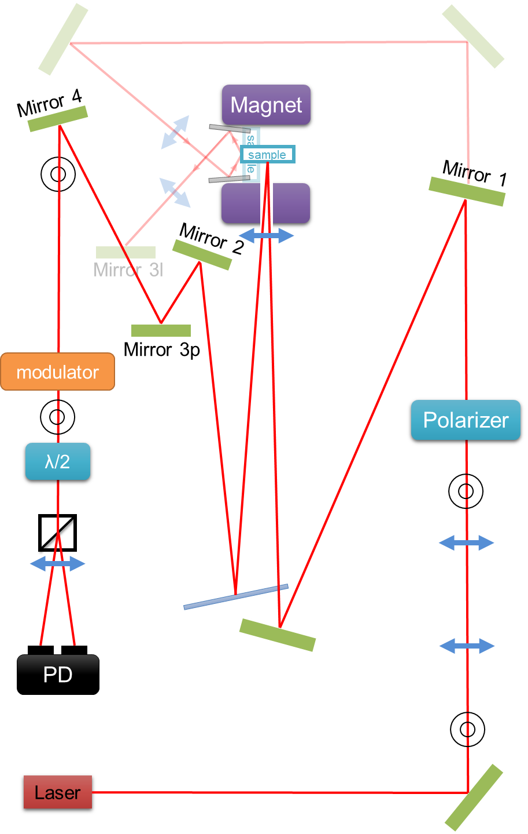
How to use the MOKE
turn on Laser, Photo-diode, Kepco, Lock-in Amplifier, Voltmeter, Modulator (Make sure that the Modulator is connected before)
Put the sample in the middle of the sample holder.
Alignment:
P-MOKE (out-of-plane): You have to put in place the mirror (Mirror 1). Then rotate the sample so the reflection get out of the magnet hole, reflect on the glass plate and get in the center of Mirror 2. Then, align with Mirror 3p and 4 to get the beam in the center of both iris.
b) L-MOKE (in-plane): Remove the mirror 1. Rotate and eventually translate the sample so the reflection get reflected on Si plate and reflect in the center of mirror 3l. . Then, align with Mirror 3l and 4 to get the beam in the center of both iris.
Get a good signal
Turn the λ/2 in order to minimize the signal in the Voltmeter (∼ tens mV).
Turn the polarizer to minimize the signal in the lock in (r). Do not forget to be 2nd order for P-MOKE and 1st order for L-MOKE
Take a measurement
In the Labview software, check signal min and max, and adjust the polarizer to be in the middle.
Do not forget to put lock-in time to 1ms, waiting time of 100ms and do the measurement. Remember that for the fine measurement the step has to be of 0.01A (the smallest one).
2 geometries : Polar MOKE and Longitudinal MOKE.

Slide 2

MOKE Longitudinal
MOKE Longitudinal
Magnet
Magnet
sample
sample
sample
sample
Polarizer
Polarizer
modulator
modulator
Polarizer
Polarizer
λ/2
λ/2
Wollaston
Wollaston
s
p
s
p
PD
PD
MOKE Polaire
MOKE Polaire
Laser
Laser
Mirror
Mirror

